Slide 1
ORGANIZATIONAL BEHAVIOR

Slide 2
Organisational Behaviour
A field of study that investigates the impact that individuals, groups, structures have on behaviour within organisations for the purpose of applying such knowledge towards improving an organisations’ effectiveness.

Slide 3
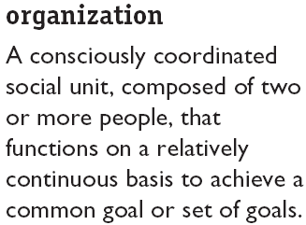

Where Managers Work

Slide 4
Management Functions
Planning
Organizing
Management
Functions
Controlling
Leading

Slide 5
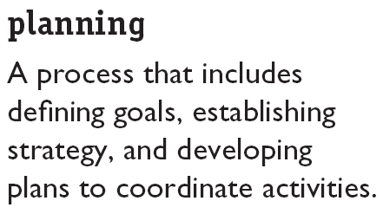

Management Functions (cont’d)‏

Slide 6
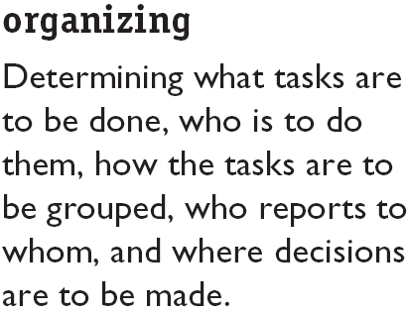
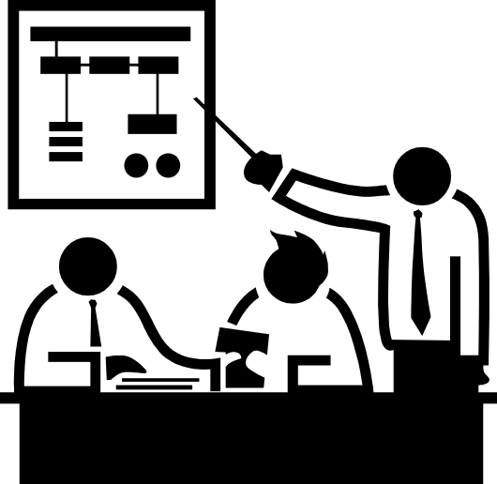
Management Functions (cont’d)‏

Slide 7
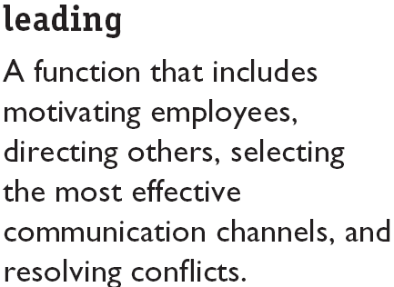

Management Functions (cont’d)‏

Slide 8
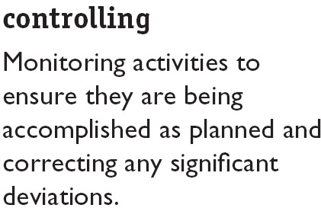

Management Functions (cont’d)‏

Slide 9
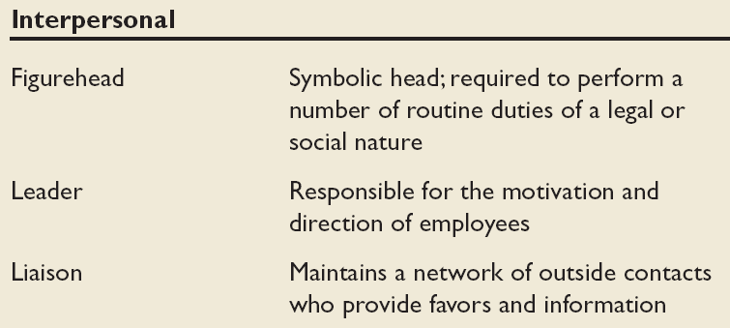
Mintzberg’s Managerial Roles (1960s)‏
A study on what managers do on their job

Slide 10
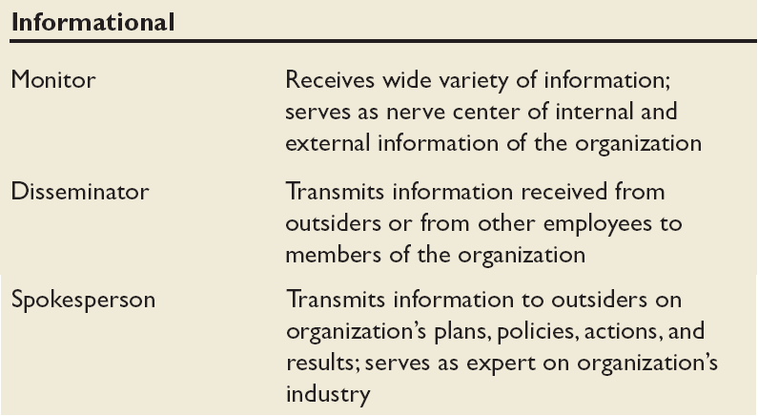
Mintzberg’s Managerial Roles (cont’d)‏

Slide 11
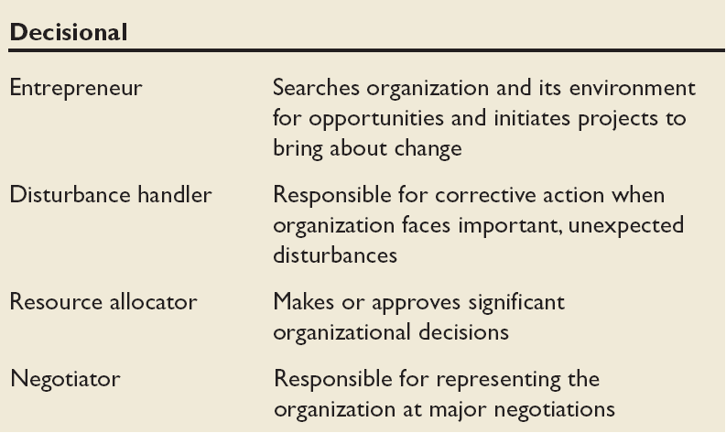
Mintzberg’s Managerial Roles (cont’d)‏

Slide 12
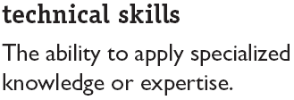

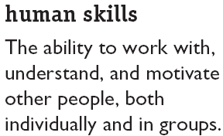
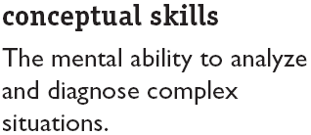
3 Management Skills – Robert Katz
Another perspective on what mangers do : look at their skills and competencies

Slide 13
Effective Versus Successful Managerial Activities (Luthans)‏
Different perspective : Do those who rise up quickly do the same activities with the same emphasis as those who do the best jobs?
Traditional management
  Decision making, planning, and controlling
Communications
  Exchanging routine information and processing paperwork
Human resource management
  Motivating, disciplining, managing conflict, staffing, and training
Networking
  Socializing, politicking, and interacting with others

Slide 14
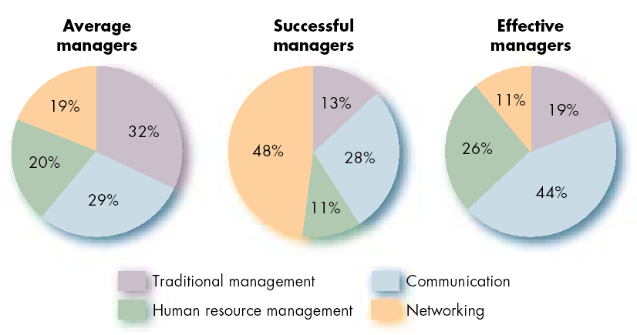
Allocation of Activities by Time

Slide 15
One Common thread that runs through the functions, roles, skills, activities and approaches to management
The importance of managing People

Slide 16
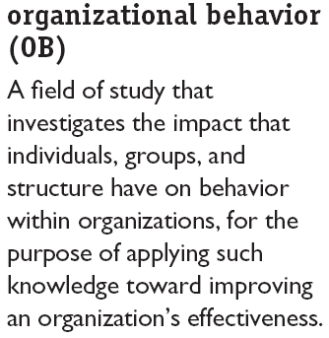
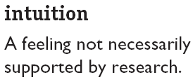
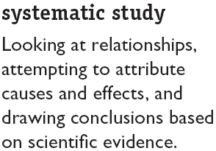
Enter Organizational Behaviour

Slide 17
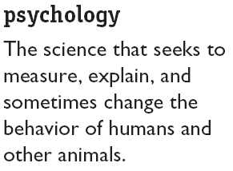
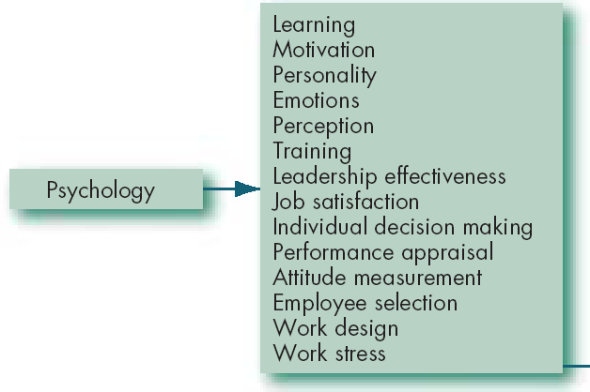
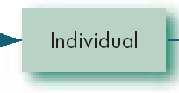
Contributing Disciplines to the OB Field

Slide 18
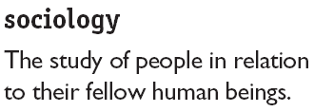
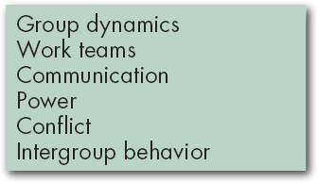


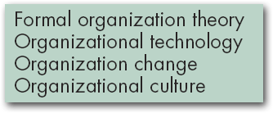

Contributing Disciplines to the OB Field

Slide 19
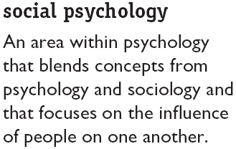
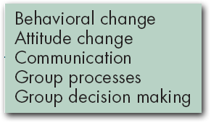

Contributing Disciplines to the OB Field

Slide 20
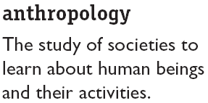
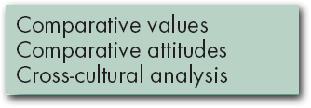


Contributing Disciplines to the OB Field

Slide 21
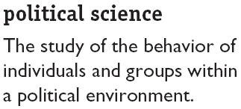
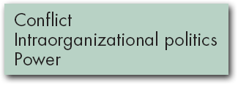

Contributing Disciplines to the OB Field

